Slide 1
CECLES
Collaborative Enrichment Course Learning Experience System
Group 06
Jeroen Vos
Sjoerd van Bekhoven
Martin Rogalla
Stephan Kool

Slide 2
Index
Hey kids, this is what we’re talking about today!
Why Cecles
Ideas and progress of Cecles
Pipelines
  Keywords
  Results
Future work
Demonstration of Cecles

Slide 3
Why CECLES
CECLES is for students
to collect relevant study material
quickly and without distraction.

Slide 4
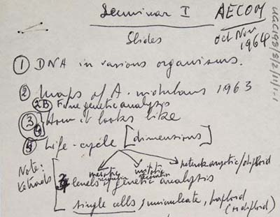





Why CECLES
Your average exam studying experience..

Slide 5



Why CECLES
How about all of that in one place?
Extract the data from the course
Personalize this for the student
Do the searches in popular and trusted channels

Slide 6
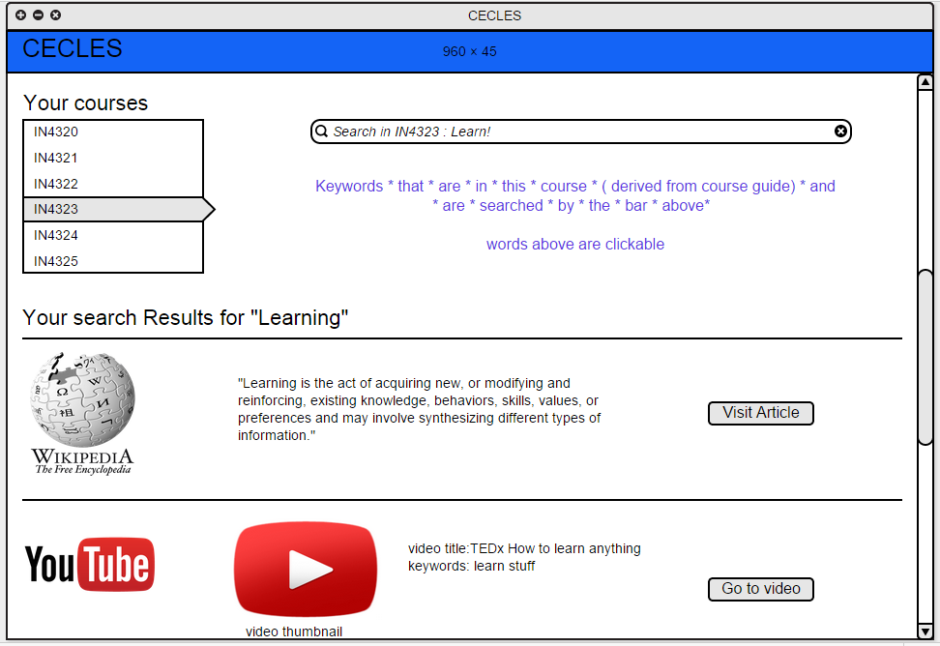
Why CECLES
How about all of that in one place?

Slide 7
Why CECLES
The goal of CECLES is to quickly provide relevant study materials for the topics given in a course a student is enrolled in.

